Slide 1
Safe Cell Tower Siting What You Need to Know Tri Town Health with Cece Doucette
October 19, 2020

Slide 2
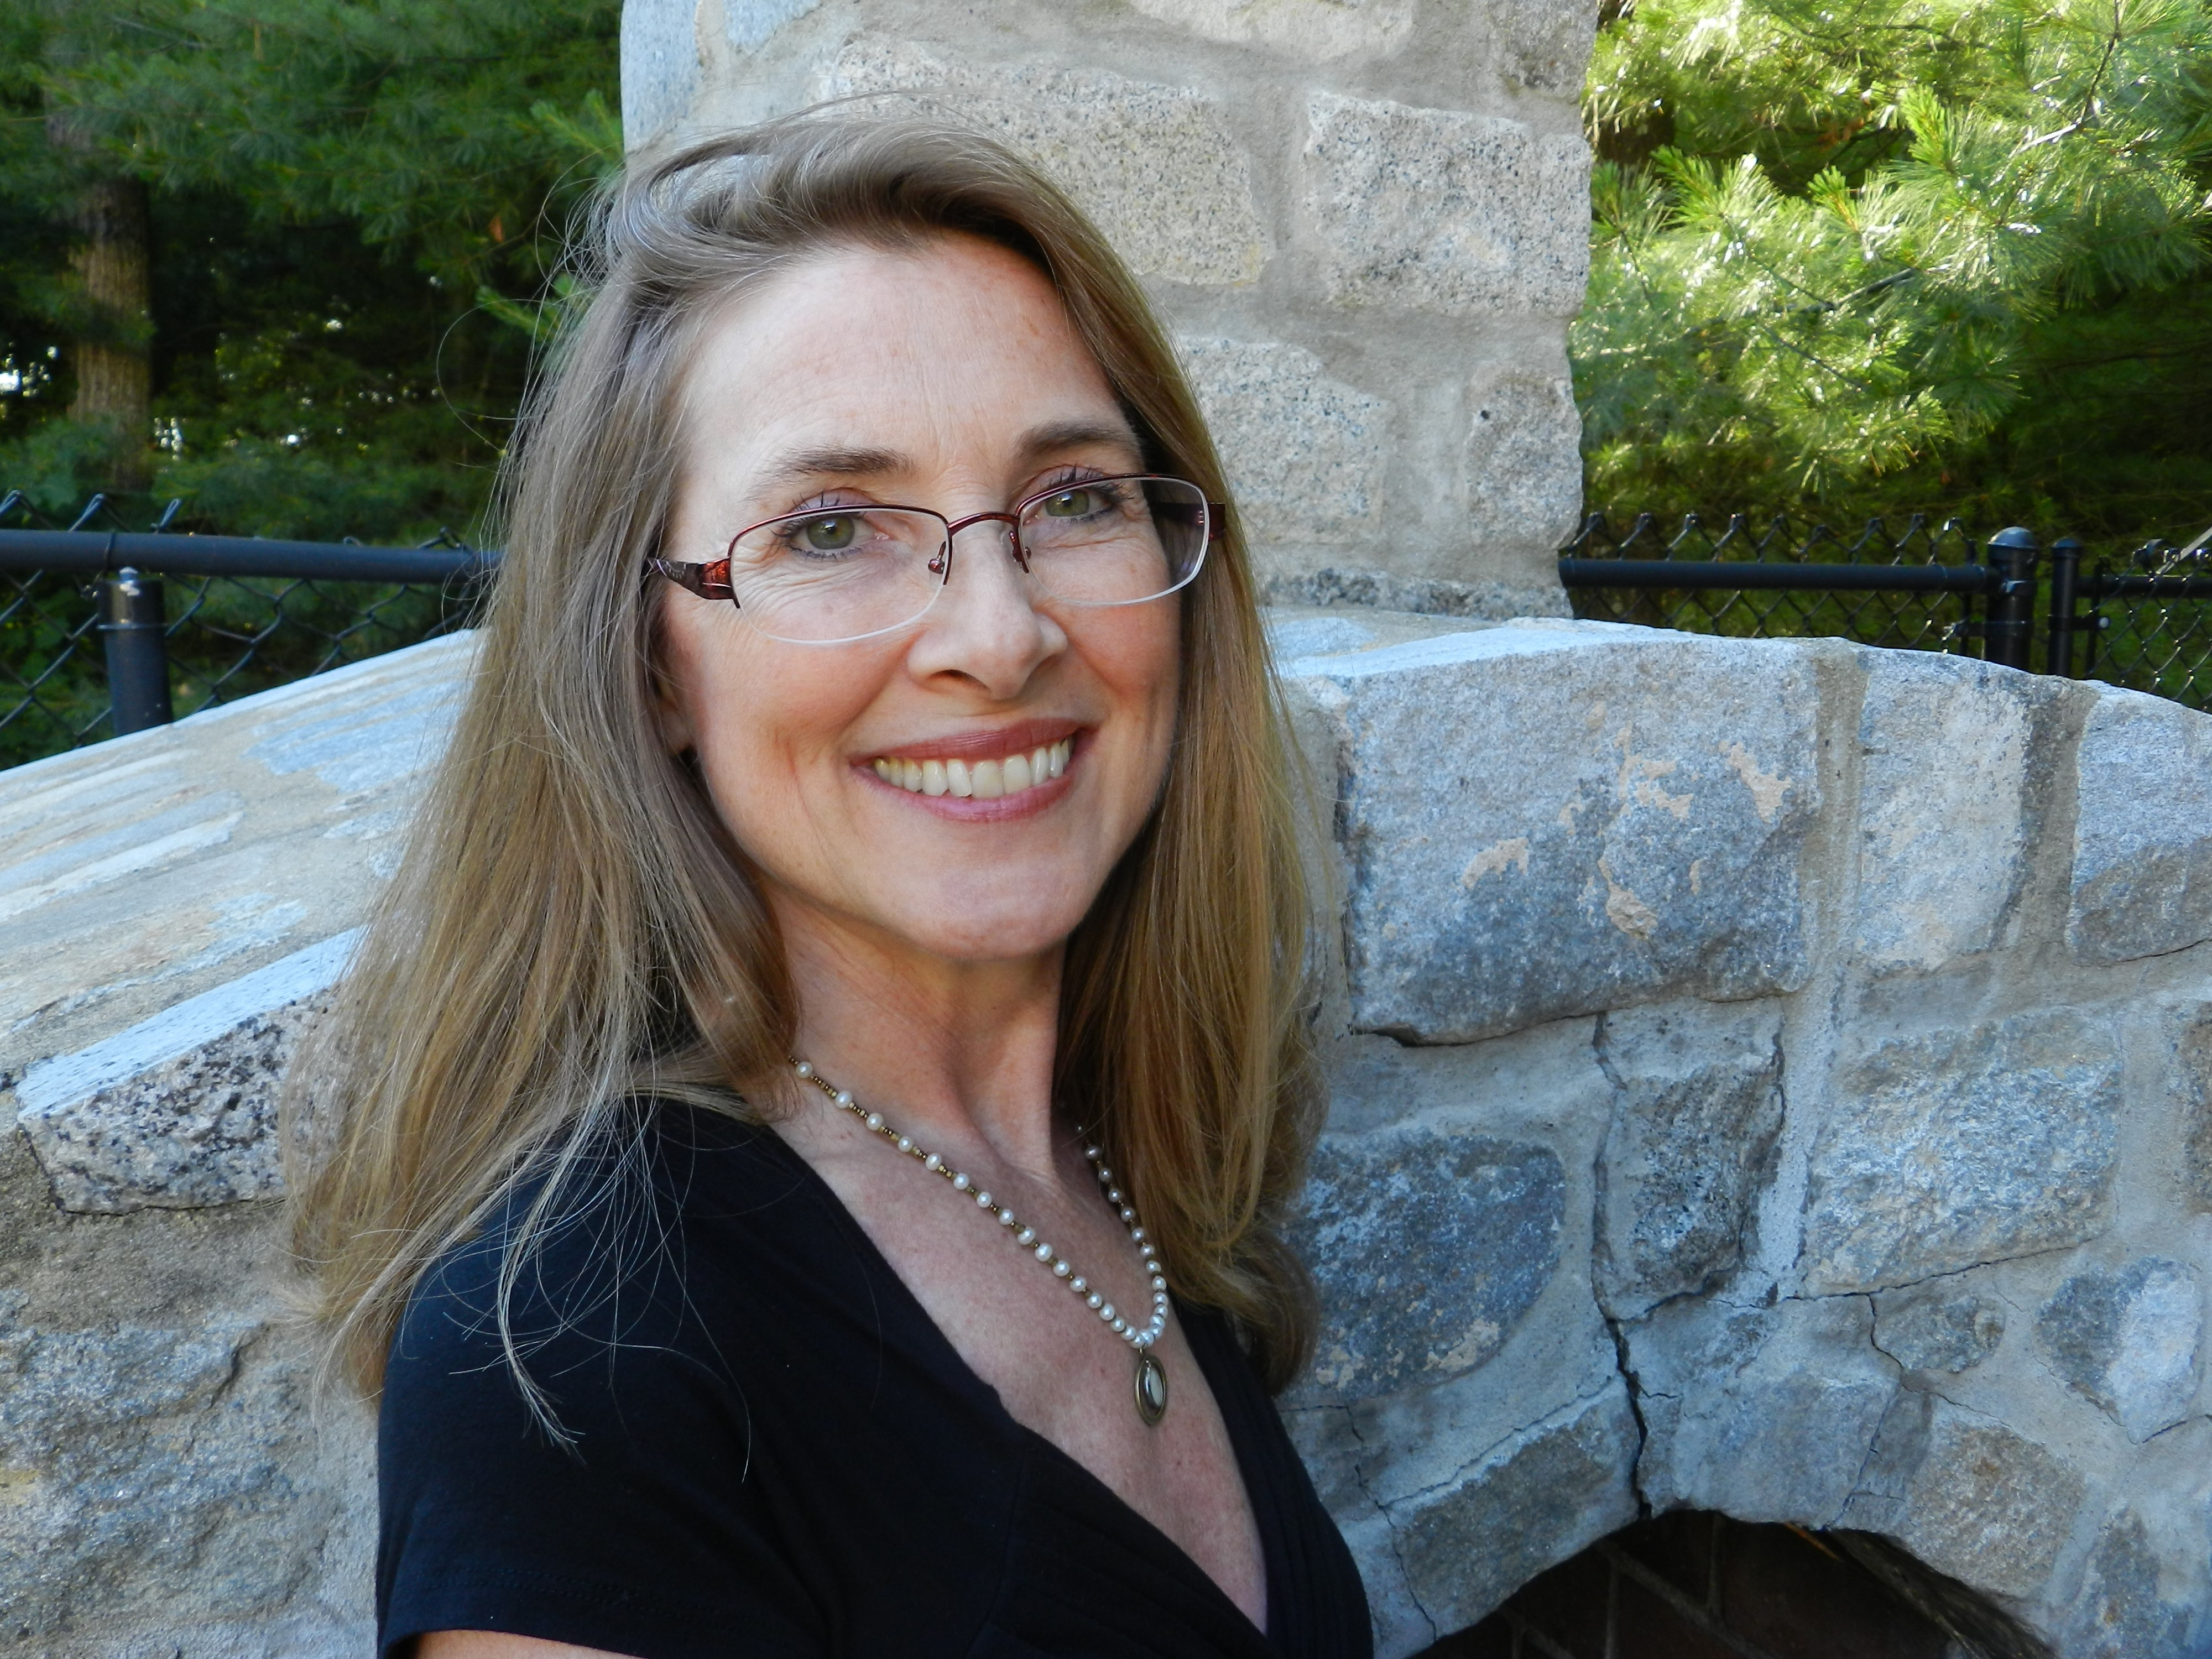
Cece Doucette, MTPW
Helped Ashland, MA become first-in-nation with Best Practices for Mobile Devices, 2014
Introduced legislation in MA & testified in NH
Co-founder, Wireless Education, educational non-profit
Co-founder, Massachusetts for Safe Technology
Co-Chair, Technology Panel, Health in Buildings Roundtable Conference @ NIH
Speaker: EMF Medical Conference 2019 and 2021

Slide 3
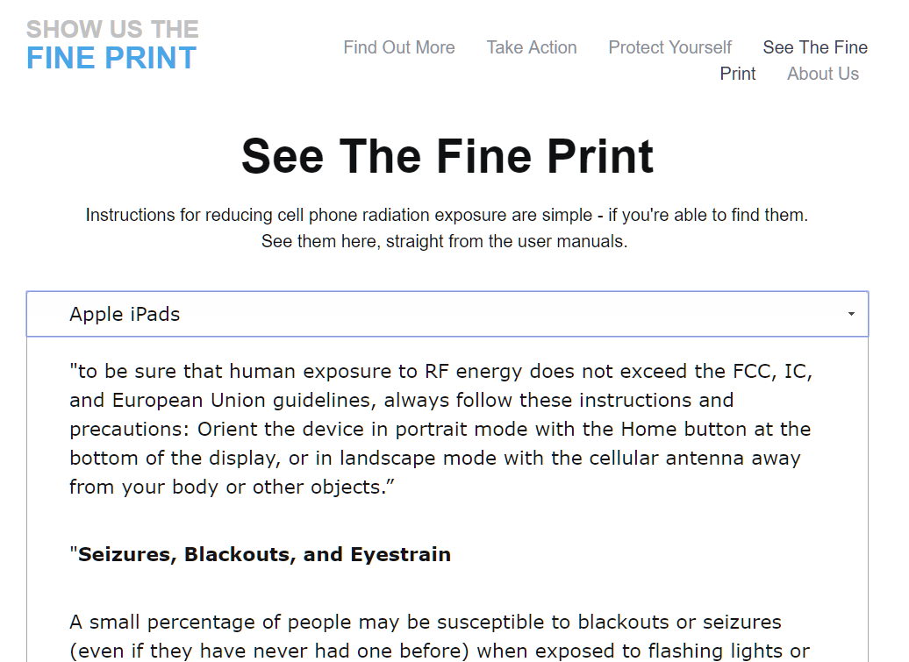
The Legal Fine Print
See the Fine Print
Settings
General
(About)
Legal & Regulatory
RF Exposure
FCC: Captured Agency
FDA: Conflict of Interest

Slide 4
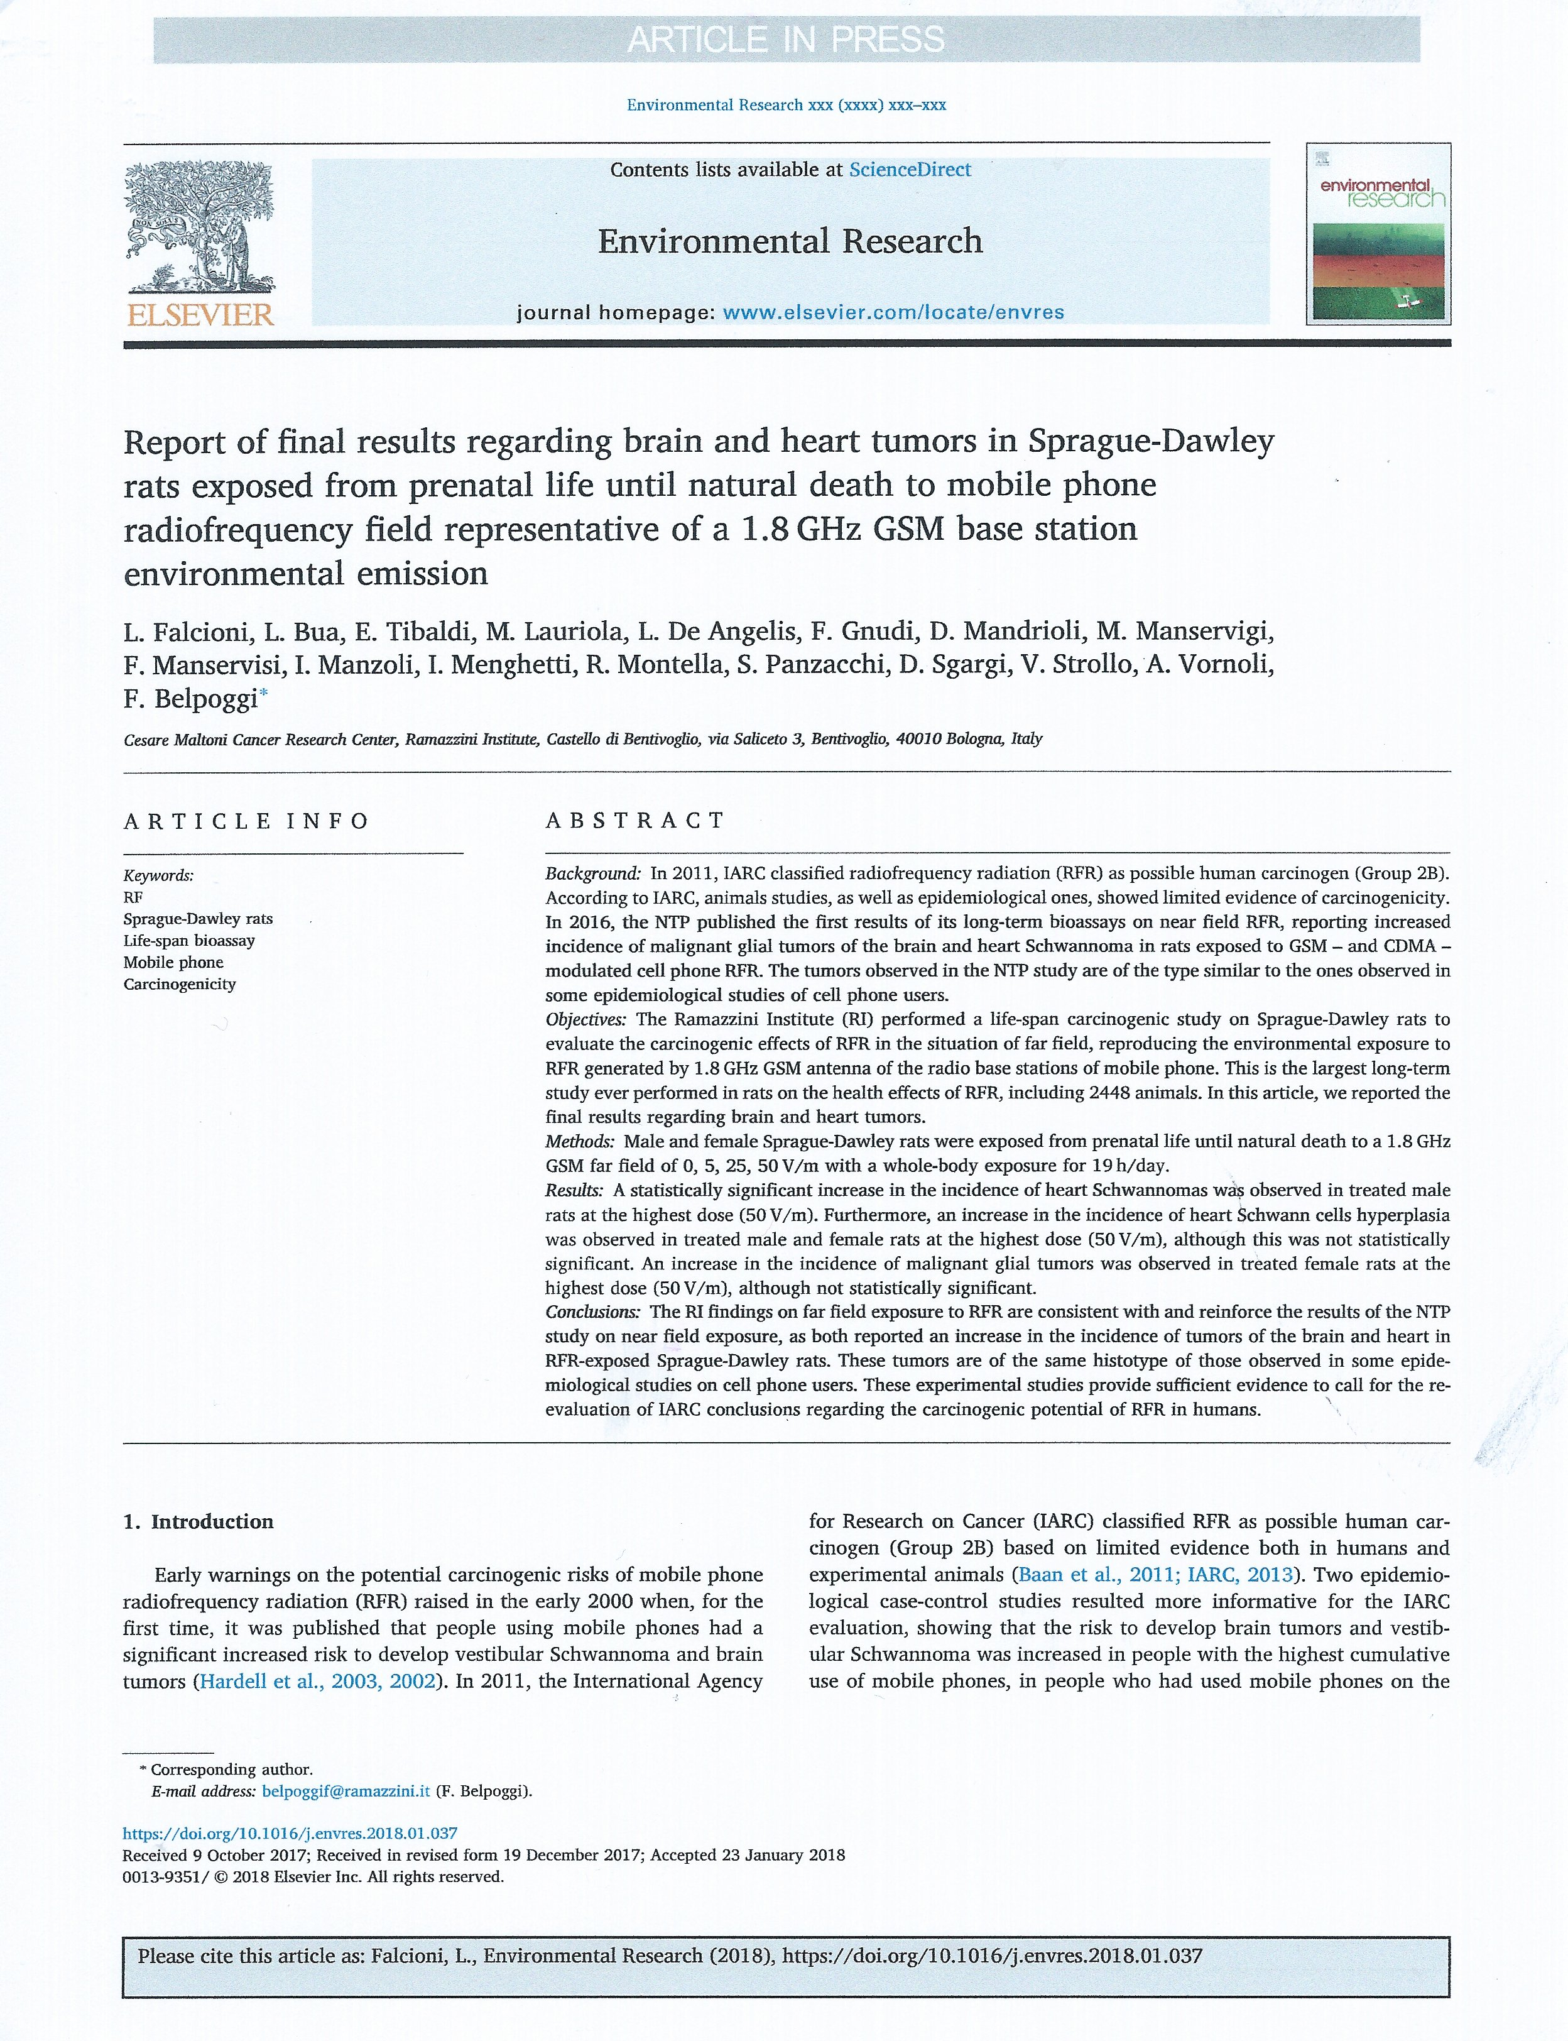
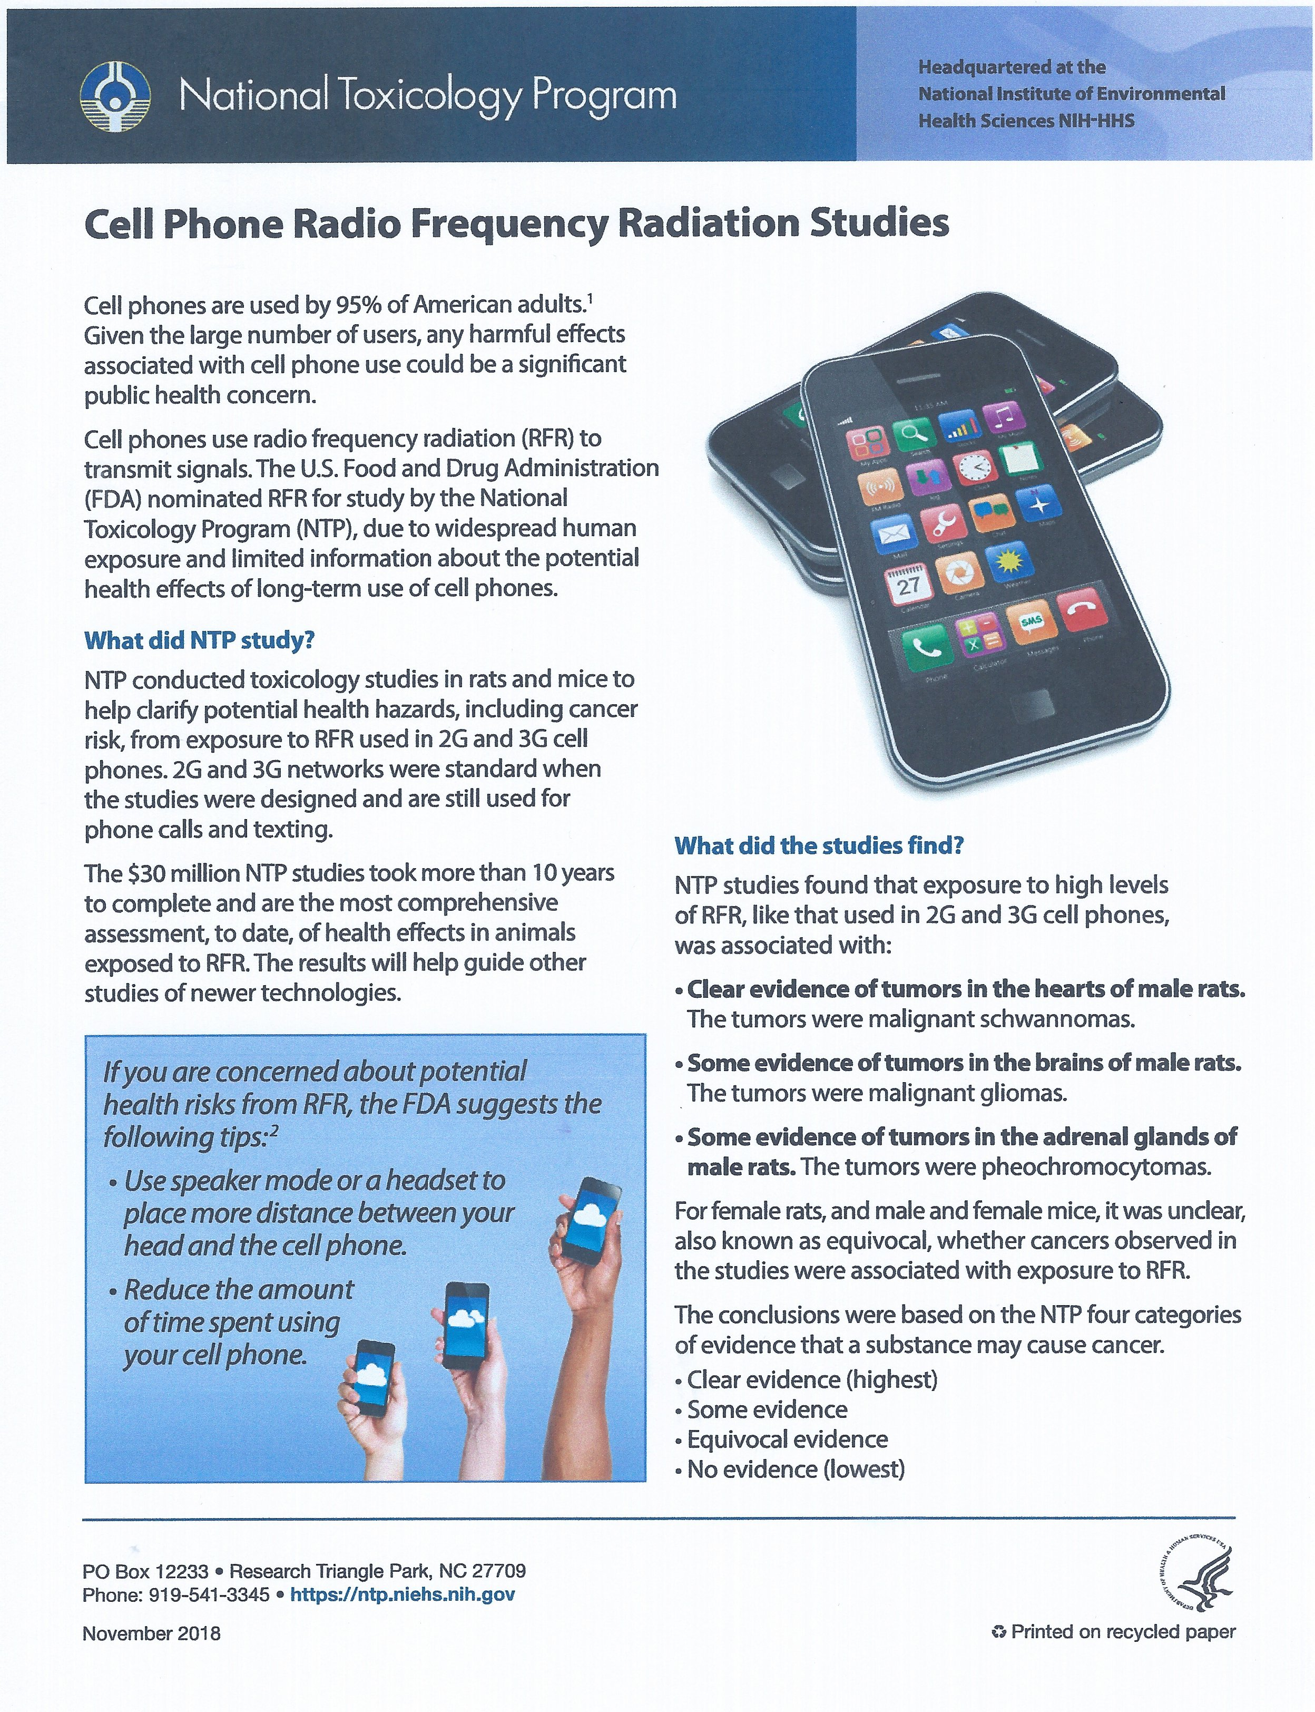
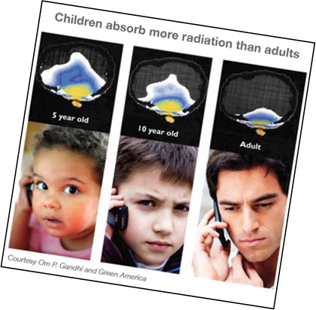
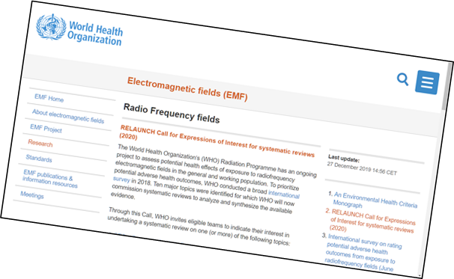
Science: Long-term Effects
Infertility
DNA Damage
Child & Adult Cancers
Neurotoxicity
ADD/ADHD
Autism
Alzheimer’s
Children are especially vulnerable
WHO re-opening investigation

Slide 5
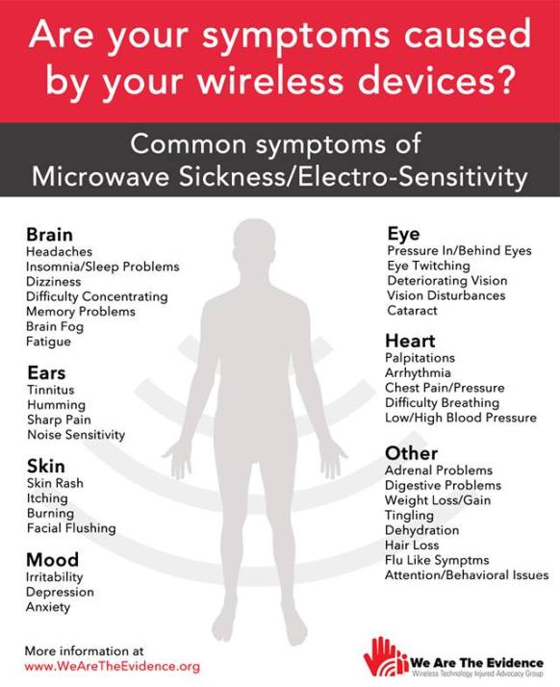
Science: Short-term Effects
Electrical Sensitivities
Insomnia
Headaches
Nosebleeds/earbleeds
Fatigue
Pain
Skin abnormalities
Irregular heartbeats
Cognitive impairment
Anger, behavior issues
Anxiety, depression, suicidal ideation

Slide 6
Science: Planetary Impact
Pollinators
Birds
Energy consumption
Mineral extraction
Data warehouses
Networks
Personal devices
Streaming
Send/receive
Charging
Continuous app updates

Slide 7
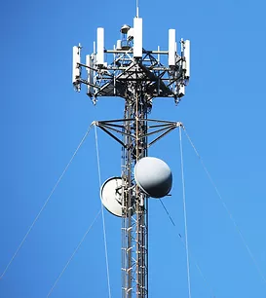
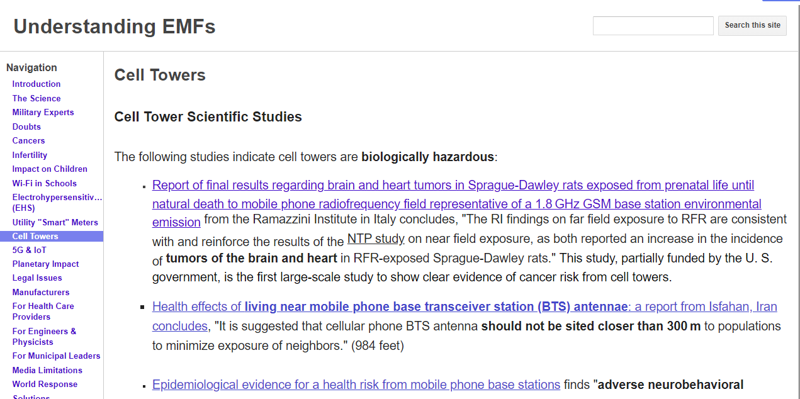
Cell Towers
Examine the non-industry funded science
AntennaSearch.com

Slide 8
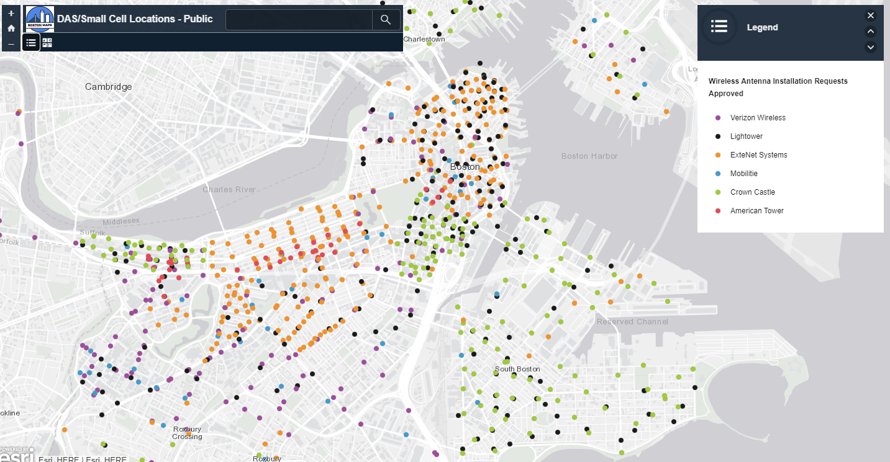
What is 5G?
5th Generation technology
Promises faster entertainment downloads, smart cities, etc.
Uses existing 3G, 4G wavelengths to penetrate buildings
5G is the addition of short millimeter waves, can’t go through objects; clear-cutting trees
Industry goal: millions of small cells at curb outside bedrooms in public access way, every 2-12 houses; already in Boston and elsewhere
Thousands of 5G satellites in the sky
Never tested for safety (Congressional hearing)
ComputerWorld: 5G a Bad Joke

Slide 9
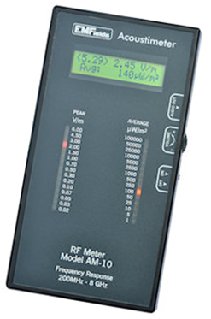
Public Taking Action
Cell towers
Shelburne, MA 1,500’ setback in bylaw
Centerville Concerned Citizens @ Cape Cod
Holliston wireless antennas on power lines
Chappaquiddick lawsuit
Wayland 900’ setback in bylaw
Dover-Sherborn Regional won
Concord relocating tower
Petersham AT&T height waiver denied
Ashland & Newton Acoustimeter in public libraries

Slide 10
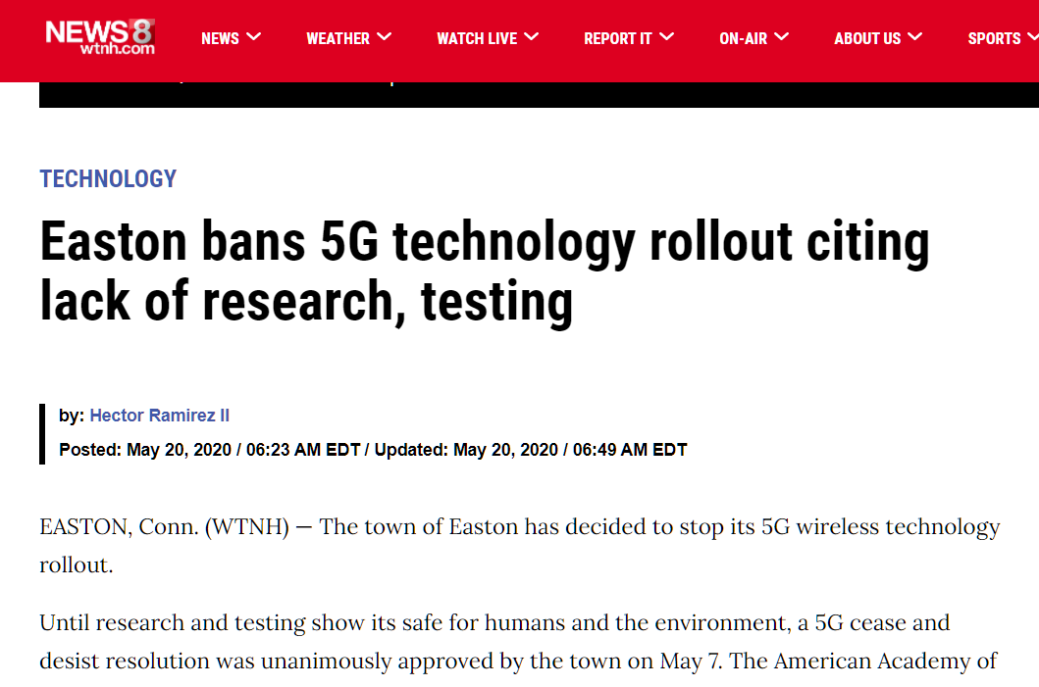
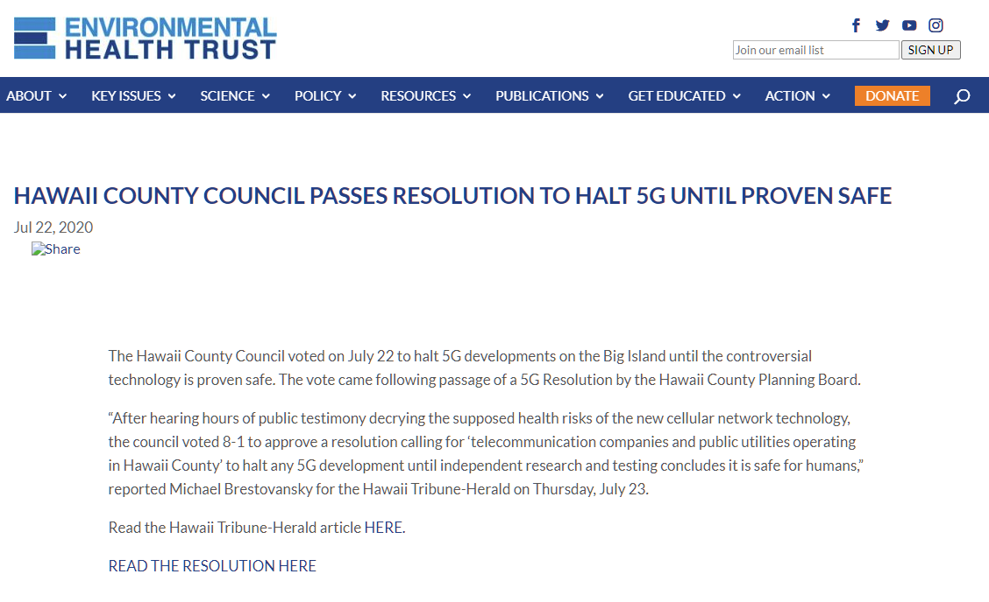
Public Servants Taking Action
City of Boston files with FCC, June 2020
Burlington, MA Small Cell Policy
National example with 5GCrisis.com
Easton, CT bans 5G
Hawaii County bans 5G
Bermuda temporary 5G moratorium
Worldwide actions

Slide 11
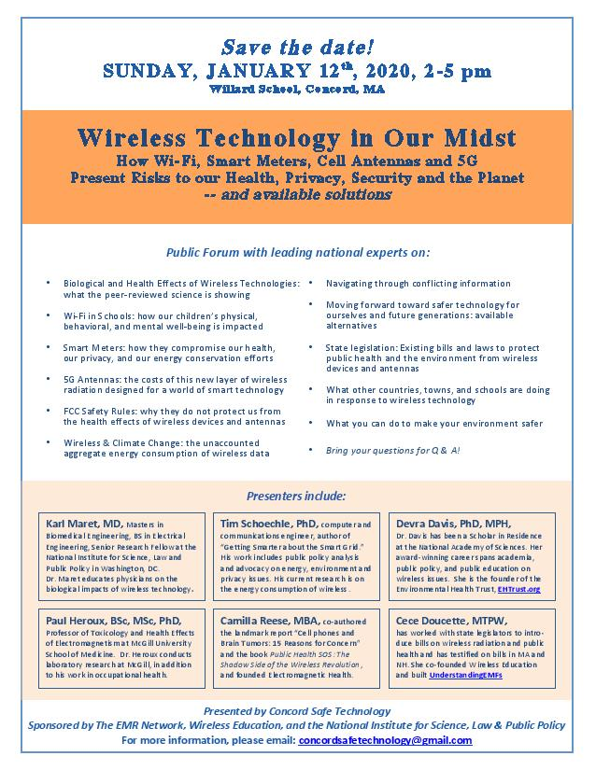
MA Towns Taking Action
City of Boston files with FCC
City of Boston sues FCC
Burlington Small Cell Policy
National example with 5GCrisis.com
Bedford, Lincoln, Andover adopting Burlington
Attorney Andrew Campanelli
Shrewsbury Board of Health
Concord Expert Forum 300+
Worcester schools RF statement

Slide 12
MA Policy Solutions
20 total bills this session
Senate Ways & Means
Joint Committee on Consumer Protection advanced Senator Cyr’s S. 129 to investigate wireless radiation
Joint Committee on Telecom, Utilities & Energy advanced Senator Moore’s S. 1988 to opt out of utility smart meters
House Ways & Means
Joint Committee on Economic Development & Emerging Technologies advanced Rep. Jones Jr.’s H. 383 to form a 5G task force; amend to also address health & environmental impact

Slide 13
National Policy Solutions
NH Rep. Patrick Abrami -- very pointed questions:
Why has the insurance industry put in RF exclusions?
Why does legal fine print say keep distance from the body?
Why are 1,000s of peer-reviewed studies ignored by FCC?
Why do FCC exposure limits not account for the non-thermal, non-ionizing, biological effects?
Why are US limits 100 times higher than other countries?
Why is the cumulative effect of increasing EMFs ignored?
New Hampshire law in less than a year, Commission reporting out in November

Slide 14
National Policy Solutions
Oregon Senator Anderson, retired public health nurse
Emergency law in less than a year
Public Health Authority to investigate non-industry peer-reviewed scientific literature
Report back on impact, especially for school children, by January
Vermont Department of Health Report, Dartmouth investigates
AK, CA, HI, IL, LA, MA, MT, NY, RI

Slide 15
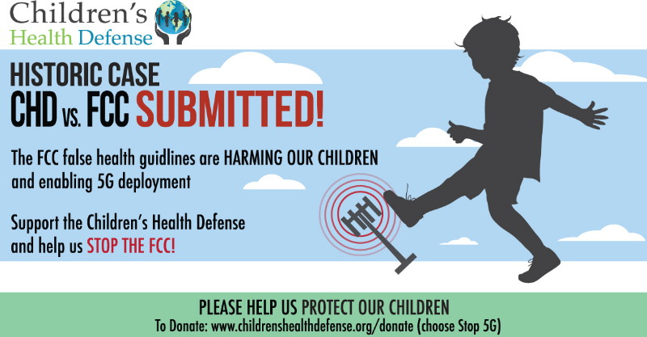
Legal Solutions
FCC being sued:
City of Boston, Aug. 2020
Environmental Health Trust
Children’s Health Defense
IRREGULATORS v. FCC
Fay School ADA: Court recognizes non-thermal biological effects
Class-action lawsuit against Apple

Slide 16
Professional Solutions
Health Care Training
EMF Conference videos, 2019
Next Conference, January 2021
Physicians for Safe Technology
Engineers, physicists, technologists, architects, etc.
Clegg et al., Building science and radiofrequency radiation: What makes smart and healthy buildings, Building and Environment, 2019
IEEE Access: Electromagnetic Radiation due to Cellular, Wi-Fi and Bluetooth technologies: How safe are we? 2020
Silicon Valley engineer Jeromy Johnson TEDx Talk

Slide 17
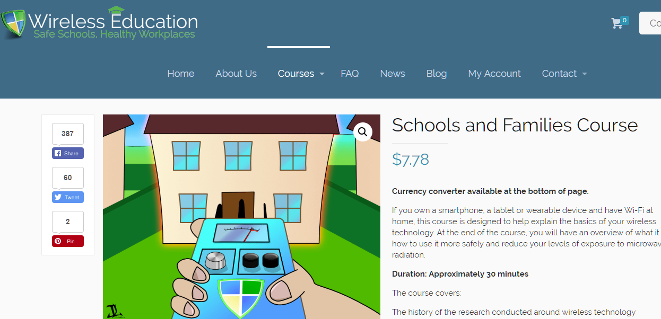
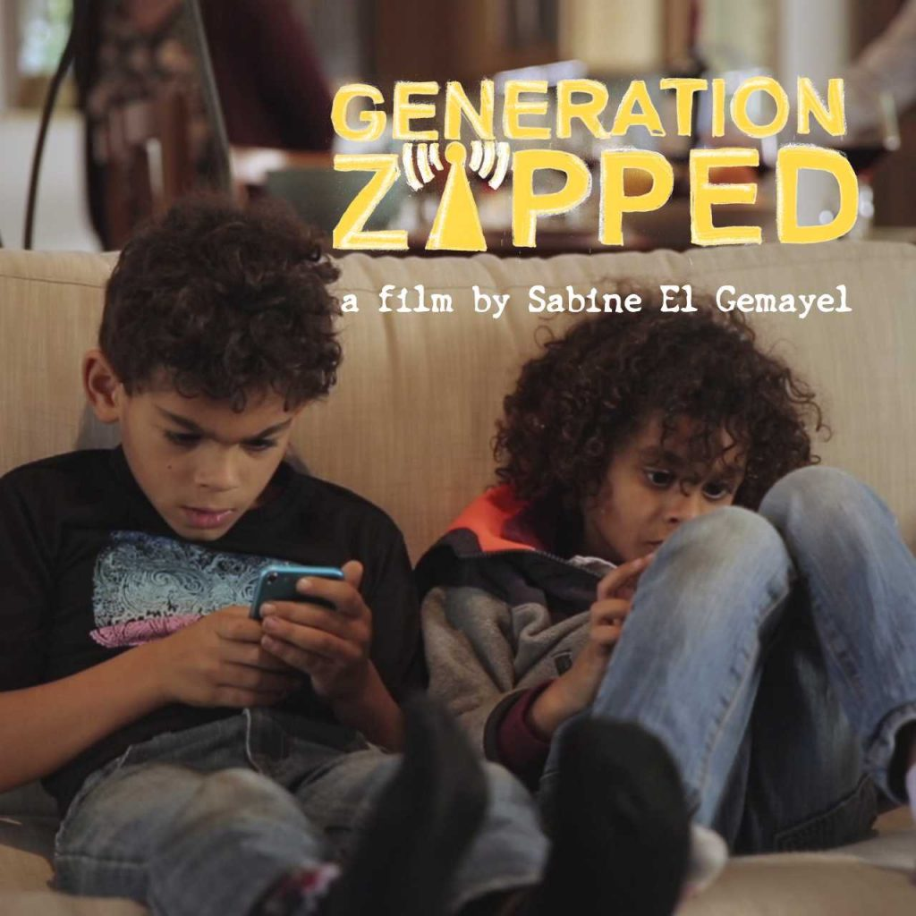
Home & Work Solutions
Non-profit Wireless Education (@30 min. on-line)
Schools & Families Course
Corporate Safety Course
Award-winning film Generation Zapped
PBS Burt Wolf 1808 & 1809
5GCrisis.com Tool Kit
Building Biology Institute consultants

Slide 18
Safe Tech Solutions: Physical & Mental Health
Avoid excessive screen time
Set limits for yourself and children
Model good behavior
50 Ways to Take a Break
The Earth Prescription

Slide 19
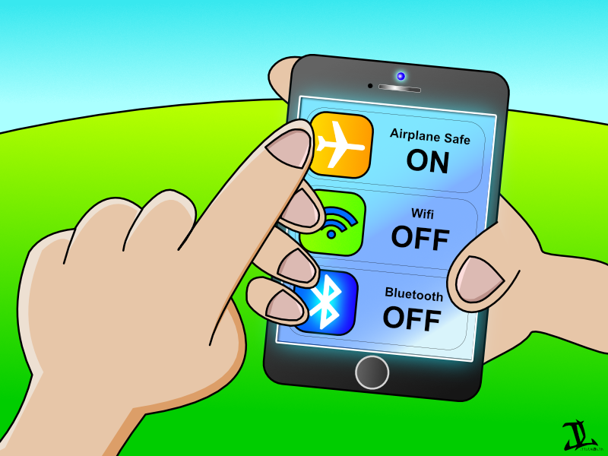
Personal Solutions
All devices off
Airplane mode
Cellular Off
Data Off
Wi-Fi Off
Bluetooth Off
Hotspot Off
Second-hand radiation: people & pets

Slide 20
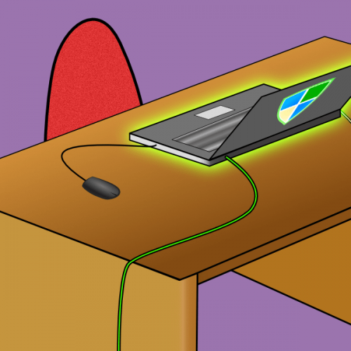
Personal Solutions
Safe technology is easier than we think: hard-wire
Router
Shielded Ethernet cables
Ethernet switch
Adapters

Slide 21
What Safe Technology Looks Like
Corded Landline Phone $30
Router
Shielded Ethernet Cable: Long @ $30
Ethernet Switch
@ $20
Shielded Ethernet Cables: Short @ $4-10
Cell Phone & Tablet Adapters @ $30

Slide 22
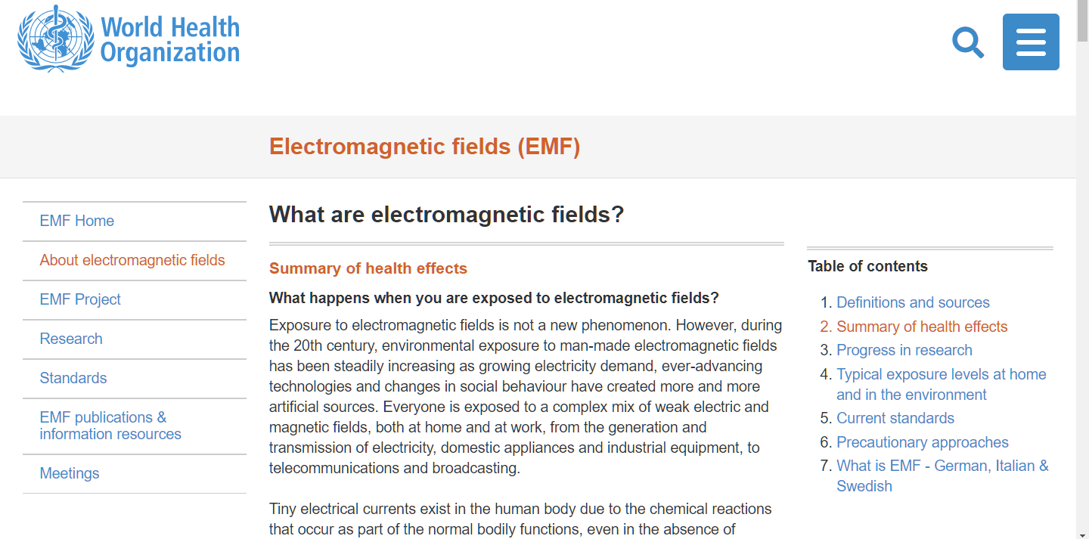
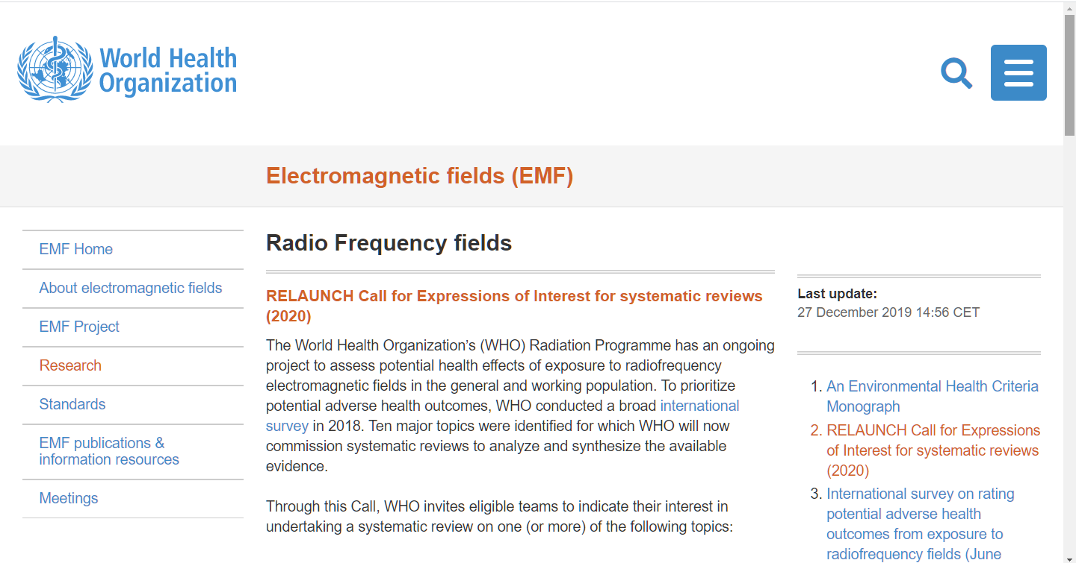
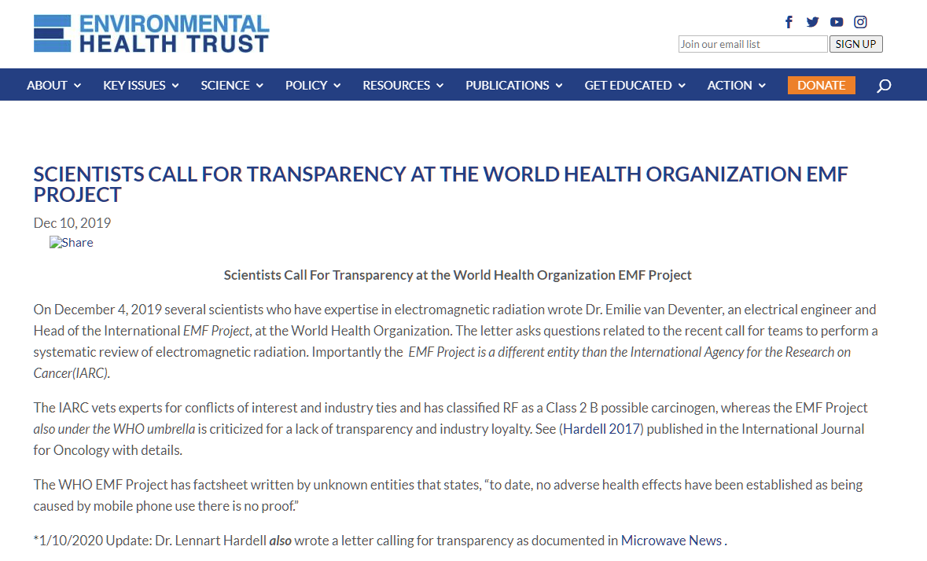
A Word of Caution: Misleading “Trustworthy” Sources
New York Times
Article, “The 5G Health Hazard that Isn’t”
Violation of truth & accuracy code
Conflict of interest: 5G Verizon lab at NYT
World Health Organization
False EMF information still posted
2020: EMF investigation reopened
Two WHO groups: One industry-influenced, one science-based

Slide 23
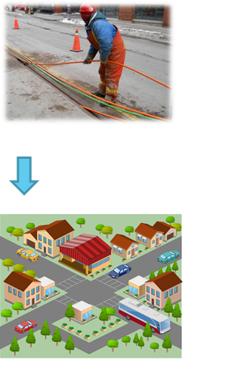
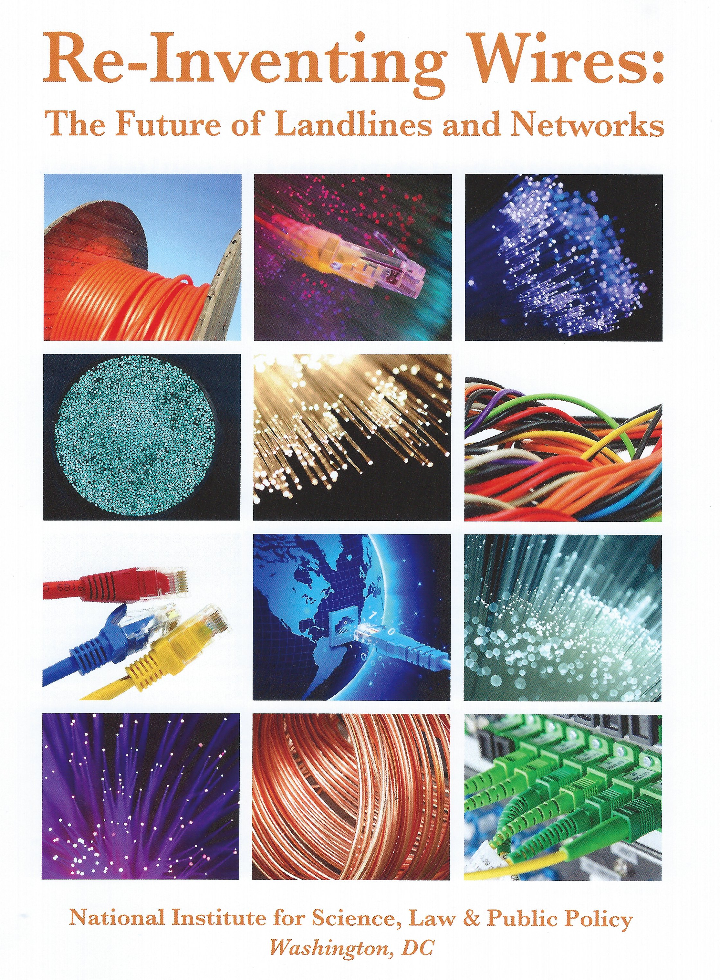
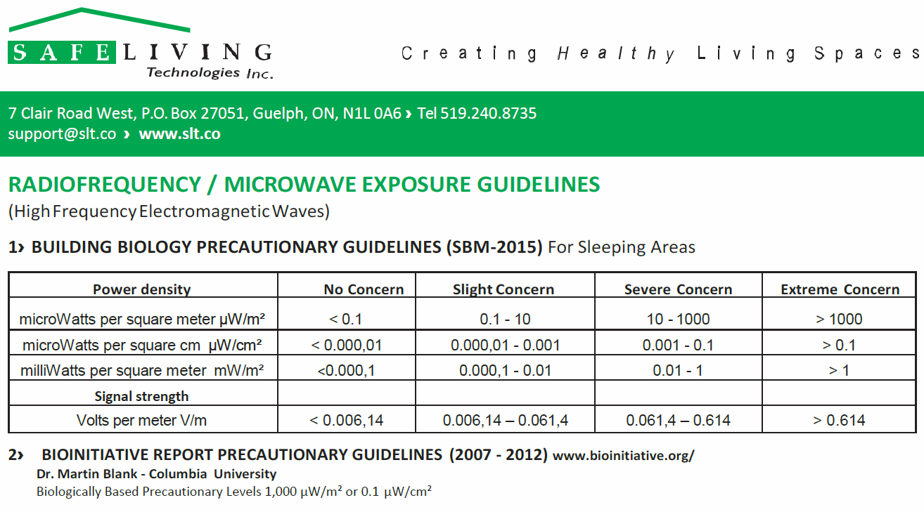
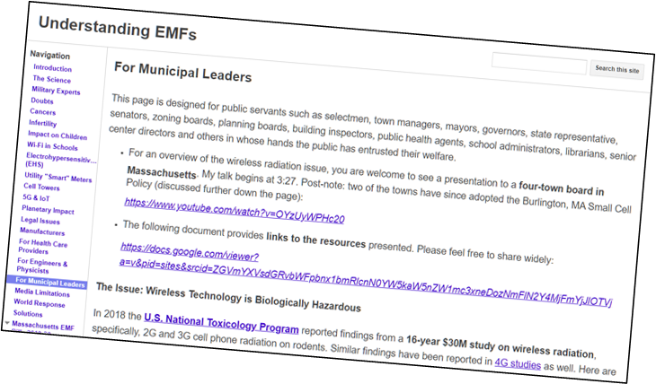
Safe Tech Solutions: Municipal Level
Differentiate industry priorities vs. public’s
Reinventing Wires: The Future of Landlines and Networks
Measure vs. biological effects
ALARA, As Low As Reasonably Achievable (CDC)
Resources for Municipal Leaders
Attorney Andrew Campanelli

Slide 24
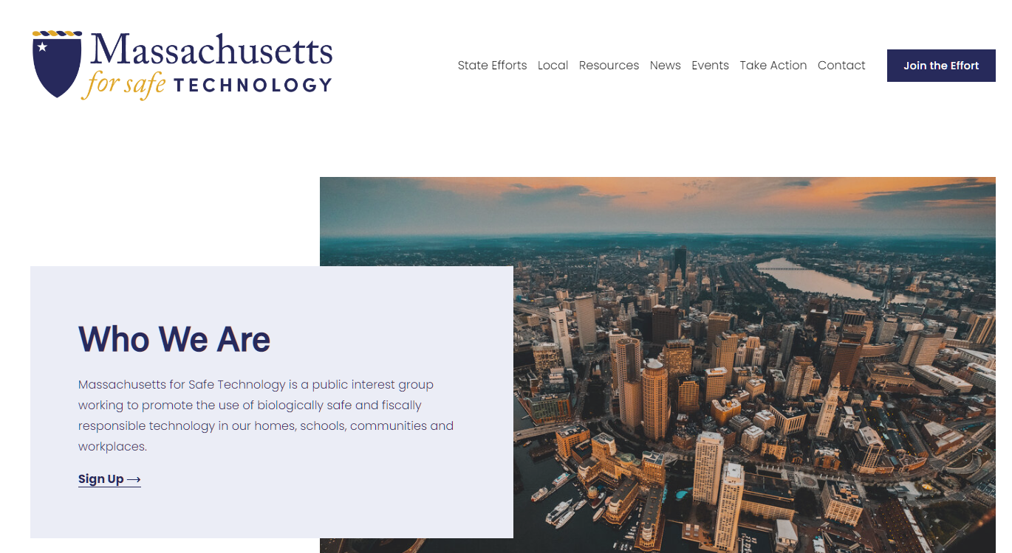
Thank You!
Massachusetts for Safe Technology
MA4SafeTech@gmail.com
WirelessEducation.org

